Slide 1
CHEMFLOW
AUCTION
EQUIPMENT BROCHURE

Slide 2
Criteria for judging:
Marks will be awarded for the following pointers:
Correct arrangement of the equipment bought during the auction.
Overall efficiency of the plant.
Answers to the questions at the end of the auction.

Slide 3
Problem Statement:
Oil spills severely damage aquatic ecosystems and coastal life. Chemical dispersants are critical in limiting this damage by breaking oil slicks into biodegradable droplets. C12–C15 Pareth-9 is a greener surfactant developed for this purpose. Designing its manufacturing plant highlights how chemical engineering can contribute to the protection of aquatic environments—capturing the spirit of Aquessence.

Slide 4
C12–C15 Pareth-9- Overview
C12–C15 Pareth-9 is a non-ionic surfactant made of a linear C12–C15 fatty alcohol chain and ~9 ethylene oxide (EO) units.
Reduces oil–water interfacial tension, enabling oil dispersion; biodegradable and low in aquatic toxicity.
Manufactured via ethoxylation: an exothermic gas–liquid reaction where EO reacts with fatty alcohol in the presence of a basic catalyst.
EO is added gradually to the liquid phase; careful process control is essential due to heat release and EO handling hazards.

Slide 5
Highly exothermic reaction.
Typical conditions: 140–180 °C, 2–5 bar, catalyst in low concentration.
Safety-critical constraints: EO is flammable, toxic, and explosive; oxygen <1%; closed and controlled system required.
Participants must select suitable process equipment and propose a logical plant layout.
Must consider reaction conditions, heat release, and safety.
Scope limited to equipment selection and plant configuration; no kinetics, mass/energy balances, or cost analysis.
Objective: design a safe, practical, and environmentally responsible plant for producing C12–C15 Pareth-9, reflecting the Aquessence theme of aquatic protection and restoration.

Slide 6
Process flow diagram

Slide 7
MIXING VESSEL

Slide 8
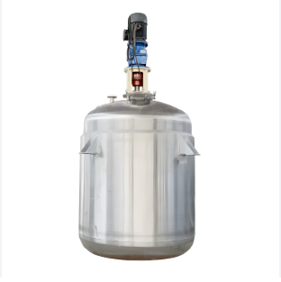
Continuously Stirred Tank Reactor (CSTR)
Provides continuous, uniform mixing of liquid-phase reactants.
Allows precise control of temperature and concentration, making it ideal for blending sensitive components.
Commonly used in chemical and pharmaceutical industries for liquid-phase reactions, continuous blending, and homogeneous reaction systems.

Slide 9
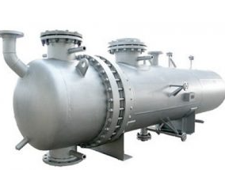
Plug Flow Reactor (PFR)
Reactants flow continuously in one direction with minimal back-mixing.
Applied where residence time distribution needs to be tightly controlled, such as continuous chemical reactions.
Suitable for reactive feeds where mixing occurs before entry into the reactor.

Slide 10
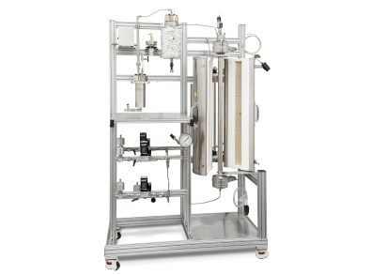
Fluidized Bed Reactor
Uses a fluidized solid bed to facilitate reactions between gases and solids or gas-liquid suspensions.
Widely employed in gas-solid catalytic processes, pyrolysis, and other industrial processes requiring suspended solids.

Slide 11
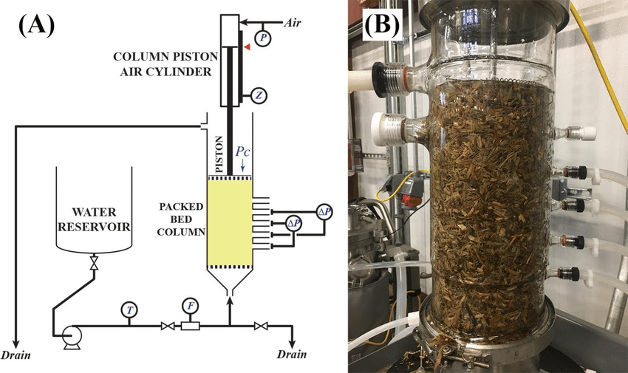
Packed Bed Reactor
Contains stationary packing or catalyst particles to support heterogeneous reactions.
Commonly used in continuous catalytic processes, gas absorption, and reactions on solid surfaces.

Slide 12
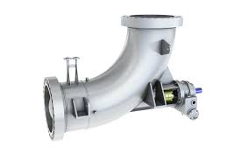
Axial Pump Circulation
Circulates liquids through pipes or tanks at high flow rates.
Typically applied in recirculation loops, feed transfer, or continuous liquid movement, but does not provide internal agitation within the vessel.

Slide 13
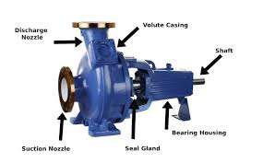
Single-Stage Centrifugal Pump
Transfers liquids efficiently by converting mechanical energy from the pump into fluid flow.
Commonly used in process piping, feeding vessels, or circulation systems, where the primary role is transport, not mixing or reaction.

Slide 14
DEHYDRATION VESSEL

Slide 15
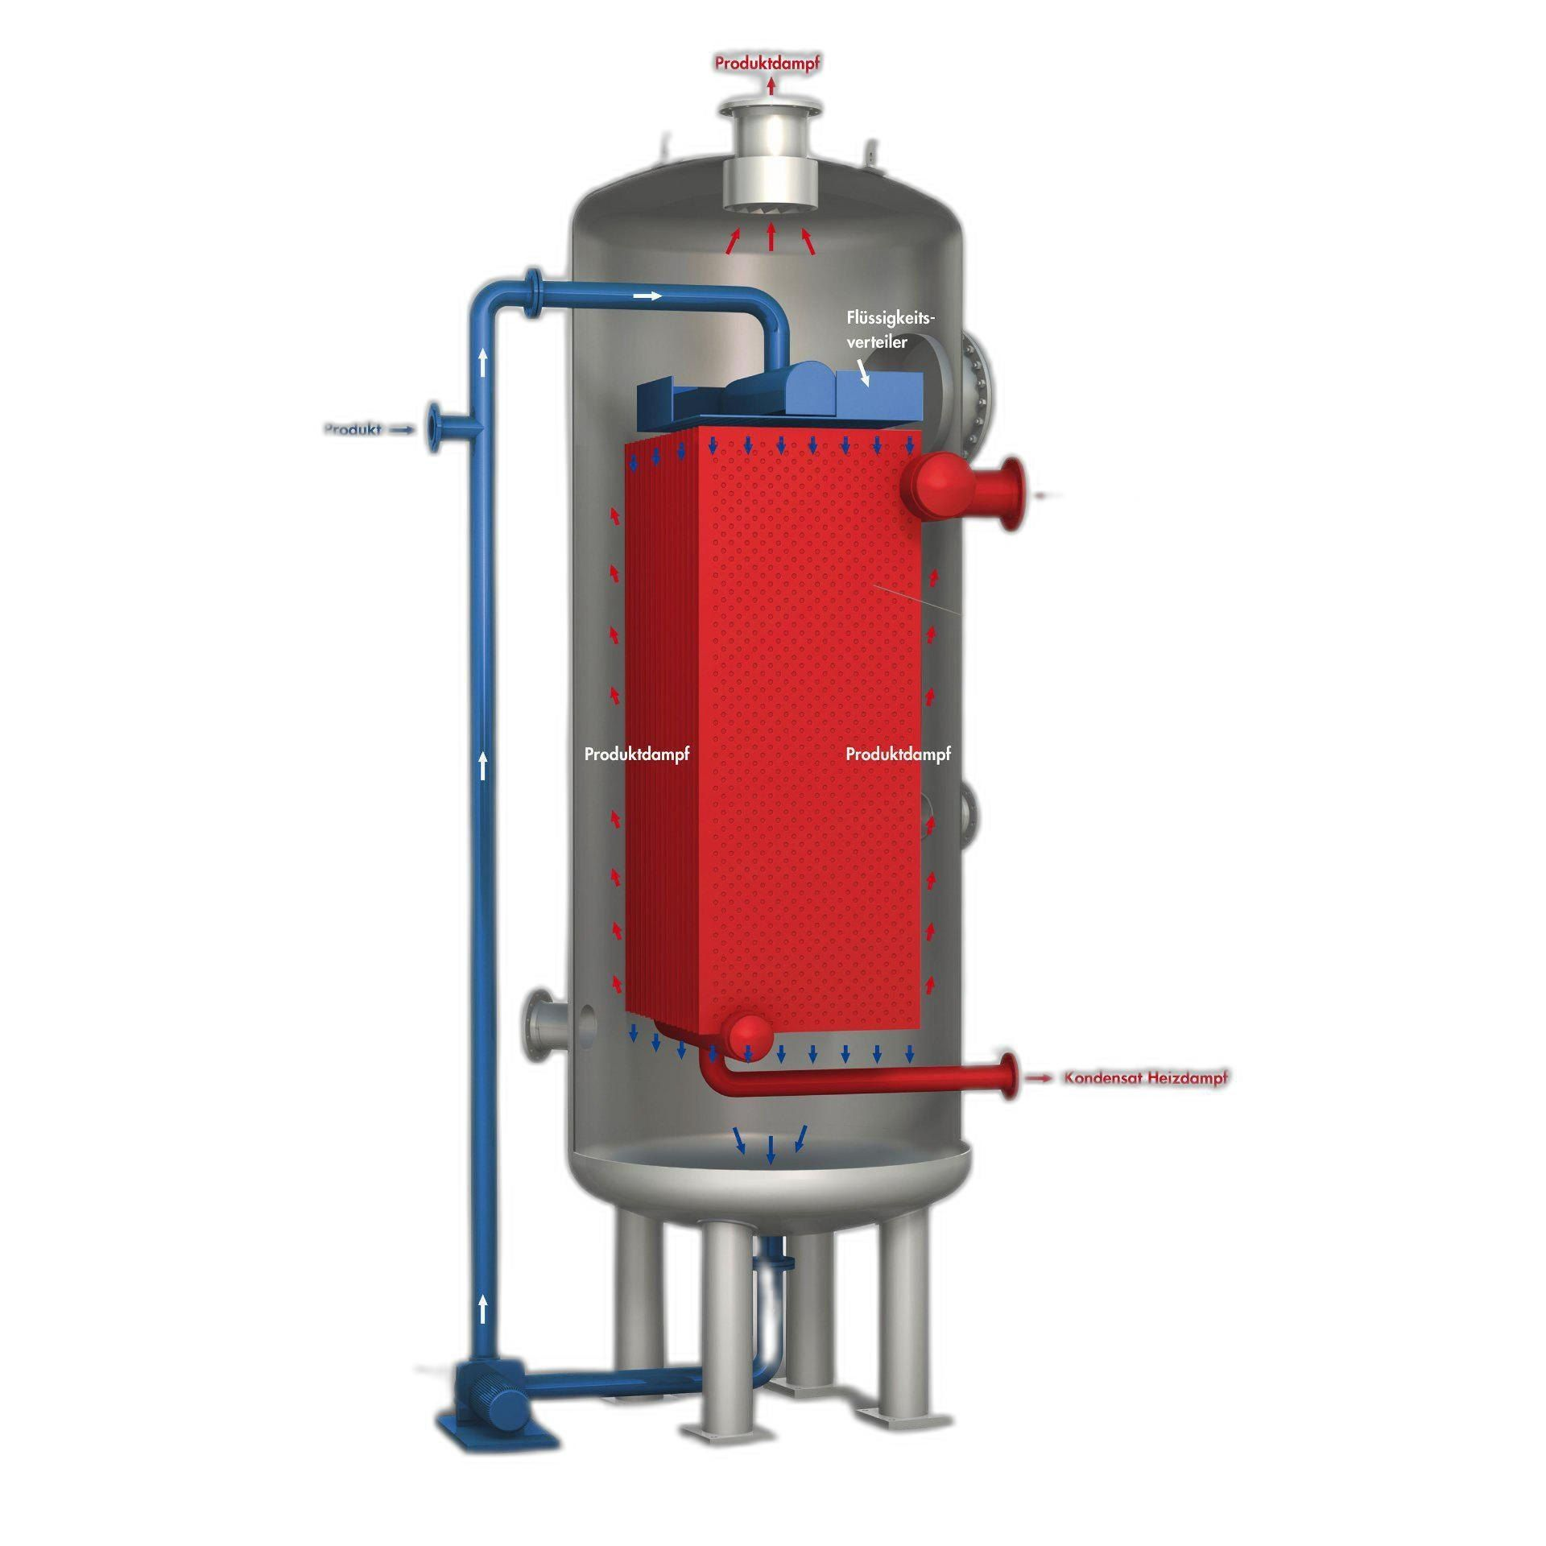
Short Tube Vertical Evaporator
Efficient for evaporating large liquid volumes.
Maintains moderate heat transfer for continuous liquid processing.
Commonly used in bulk evaporation processes.

Slide 16
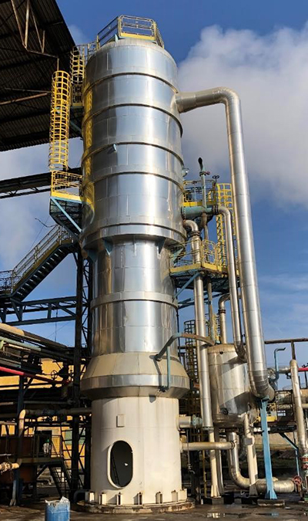
Long Tube Vertical Evaporator
Utilizes long vertical tubes for extended vaporization surface.
Supports rapid evaporation in continuous operations.
Applied in processes with low- to medium-viscosity liquids, where large throughput is required.

Slide 17
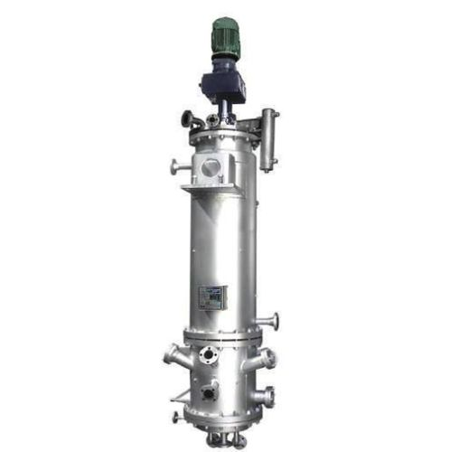
Agitated Thin Film Evaporator
Spreads liquid into a thin film on a heated surface → high heat transfer efficiency.
Minimises residence time, reducing thermal degradation.
Used for heat-sensitive and viscous liquids in continuous operation

Slide 18
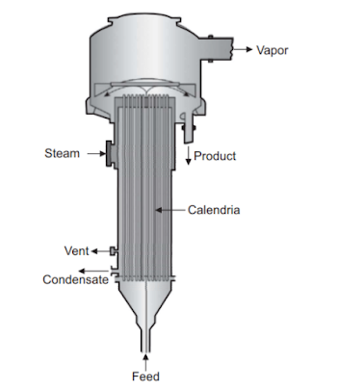
Climbing Film Evaporator
Operates by heating liquid in vertical tubes, with upward flow assisted by vapor formation.
Enables continuous evaporation of moderate-viscosity liquids.
Used in industries such as chemicals, pharmaceuticals, and food processing.

Slide 19
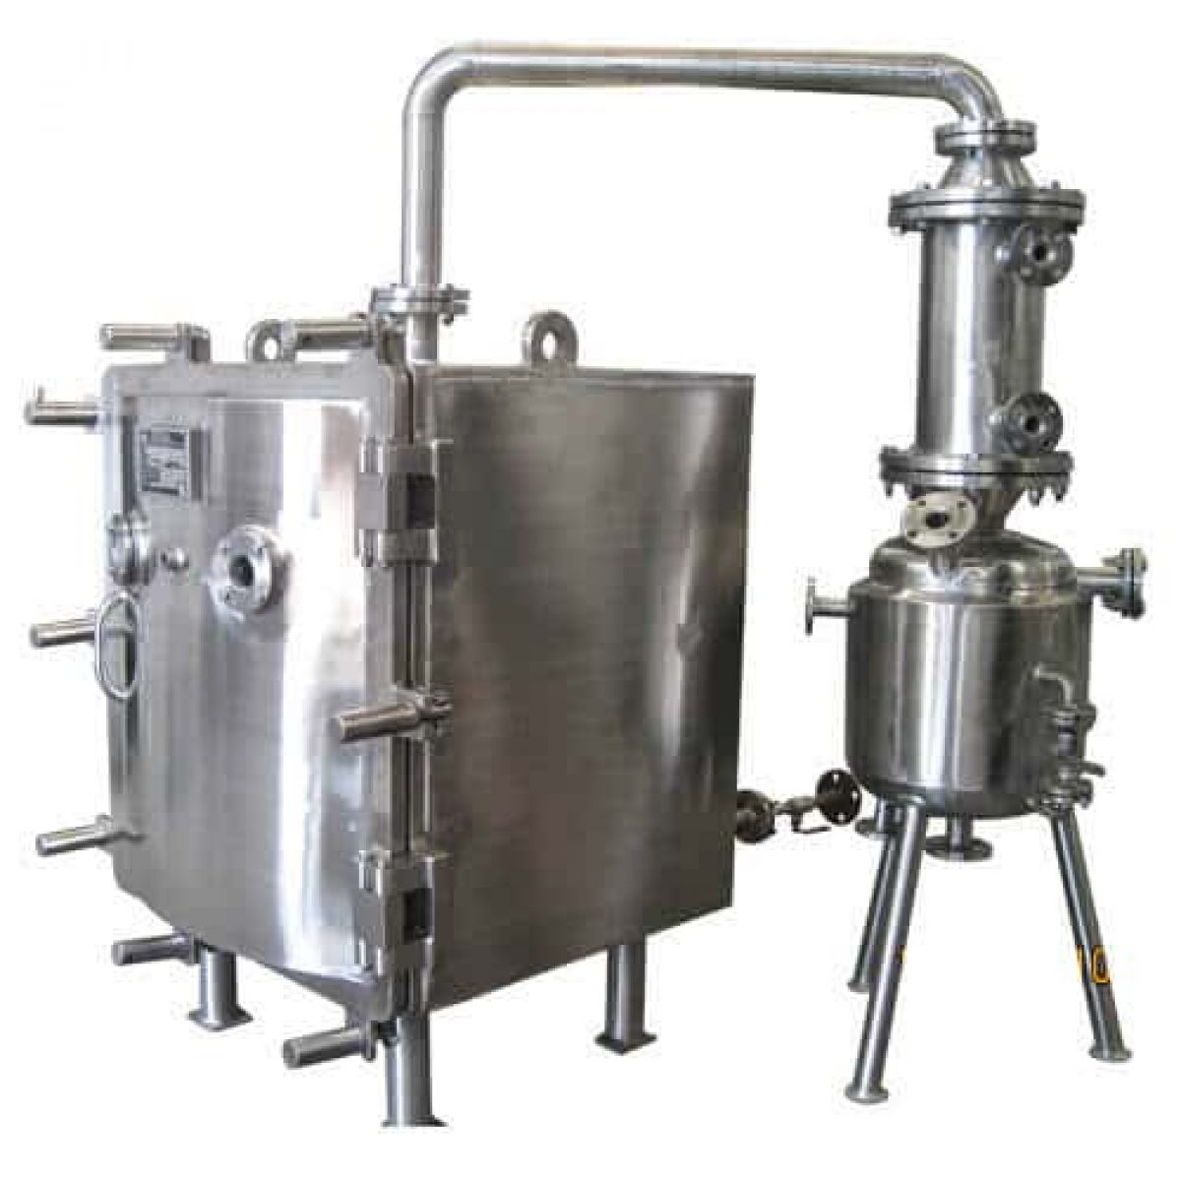
Vacuum Dryer
Provides controlled drying under reduced pressure, lowering the temperature required for evaporation.
Allows for gentle removal of moisture from liquids or semi-solids.
Commonly applied in food, pharmaceutical, and specialty chemical industries where heat-sensitive drying is needed.

Slide 20
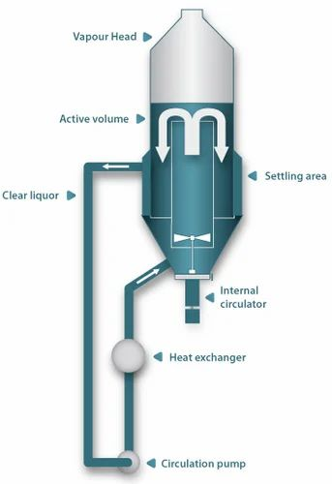
Draft Tube Baffle Crystallizer
Consists of a draft tube with internal baffles to create controlled circulation.
Ensures uniform crystal growth and size distribution in solutions.
Used in chemical and pharmaceutical industries for producing crystalline solid products from solutions.

Slide 21
REACTORS

Slide 22
Continuously Stirred Tank Reactor
CSTRs continuously mix reactants to maintain uniform composition within the reactor. The mixture flows in and out, ensuring a steady-state process.
These reactors are ideal for liquid-phase reactions and allow for easy control of reaction conditions such as temperature and concentration.
BASE PRICE:

Slide 23
Plug Flow Reactor
PFRs have a unidirectional flow where reactants move as a "plug" with minimal back-mixing, ensuring consistent residence time for each segment of the fluid
These reactors are efficient for reactions that require precise control over reaction time and typically have higher conversion rates due to reduced axial mixing.
BASE PRICE:

Slide 24
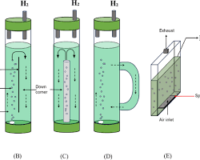
Internal Loop Bubble Column
Internal loop bubble columns use internal circulation to promote gas-liquid interaction, improving mixing and mass transfer efficiency.
They are commonly used for processes needing effective phase contact and operate with minimal mechanical complexity.
BASE PRICE :

Slide 25
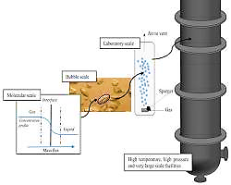
External Loop Bubble Column
External loop bubble columns feature an external circulation loop to enhance gas-liquid interaction and improve mixing efficiency.
These reactors are ideal for large-scale operations, offering better control overflow patterns and scalability while minimizing mechanical parts.
BASE PRICE :

Slide 26
Fluidised Bed Reactor
Fluidized bed reactors pass a fluidization medium through a solid bed, suspending particles to enhance mixing and reaction.
They are ideal for processes requiring high heat input and allow for straightforward catalyst regeneration.
BASE PRICE :

Slide 27
Packed Bed Reactor
Packed bed reactors consist of a bed of solid catalyst materials through which reactants flow, enabling efficient catalytic reactions.
They are commonly used in gas-phase and liquid-phase processes, offering good control overflow rates and reaction conditions.
BASE PRICE :

Slide 28
HEAT EXCHANGERS

Slide 29
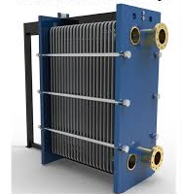
Plate Heat Exchanger (PHE)
Provides high surface-area-to-volume ratio for rapid heating or cooling.
Allows precise temperature control, important for sensitive reactions.
Can be disassembled easily for cleaning and maintenance.

Slide 30
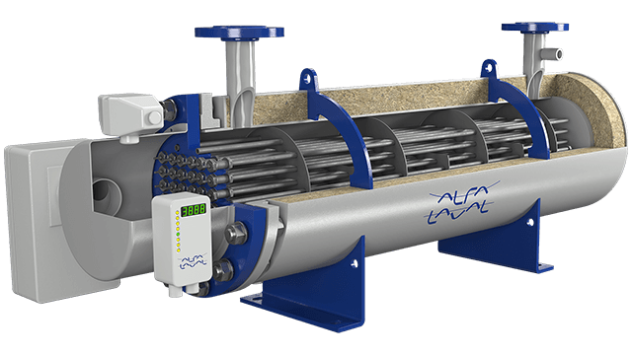
Shell & Tube Heat Exchanger
Contains a series of tubes in a shell where fluids exchange heat.
Handles high pressures and large flow rates, suitable for general heating/cooling.
Commonly used in utility loops and process streams.

Slide 31
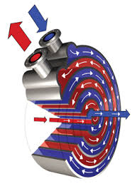
Spiral Heat Exchanger
Coiled channels create turbulent flow, improving heat transfer.
Effective for viscous liquids, minimizing fouling.
Often used where continuous heating or cooling of thick liquids is required.

Slide 32
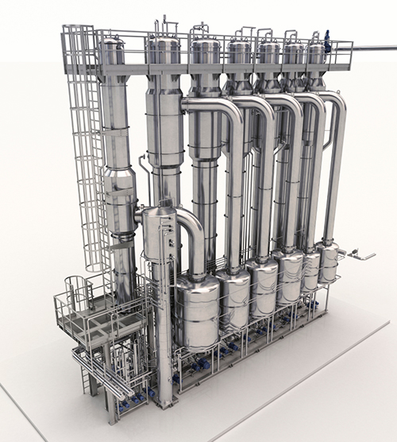
Falling Film Heat Exchanger
Liquid flows as a thin film over heated tubes, allowing rapid heat transfer.
Ideal for sensitive liquids or dehydration processes where short residence time is needed.

Slide 33
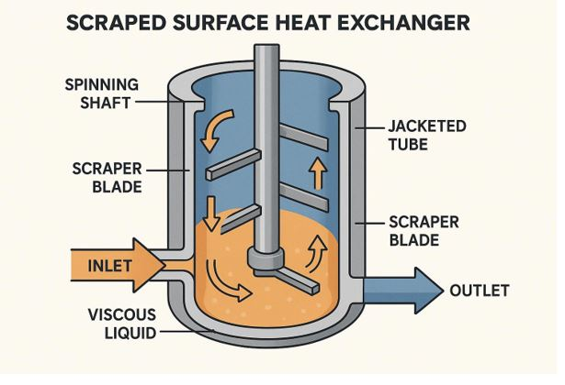
Scraped Surface Heat Exchanger
Contains a rotating wiper to scrape internal walls continuously.
Ensures uniform heat transfer for viscous or semi-solid products.
Prevents product buildup and allows continuous processing of thick liquids.

Slide 34
PUMPS

Slide 35
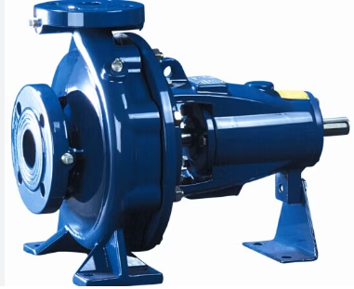
Single-stage Centrifugal pump
A pump with one impeller that efficiently moves fluids at low to moderate pressures. It is commonly used for water circulation and general fluid transfer.
Known for its simple design and reliability in various applications
BASE PRICE :

Slide 36
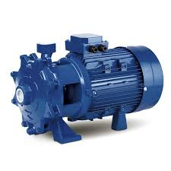
2-stage Centrifugal pump
Equipped with two impellers, this pump provides higher pressure output compared to a single-stage pump. It is ideal for applications requiring increased head and flow.
Commonly used in industrial water supply and pumping systems.
BASE PRICE

Slide 37
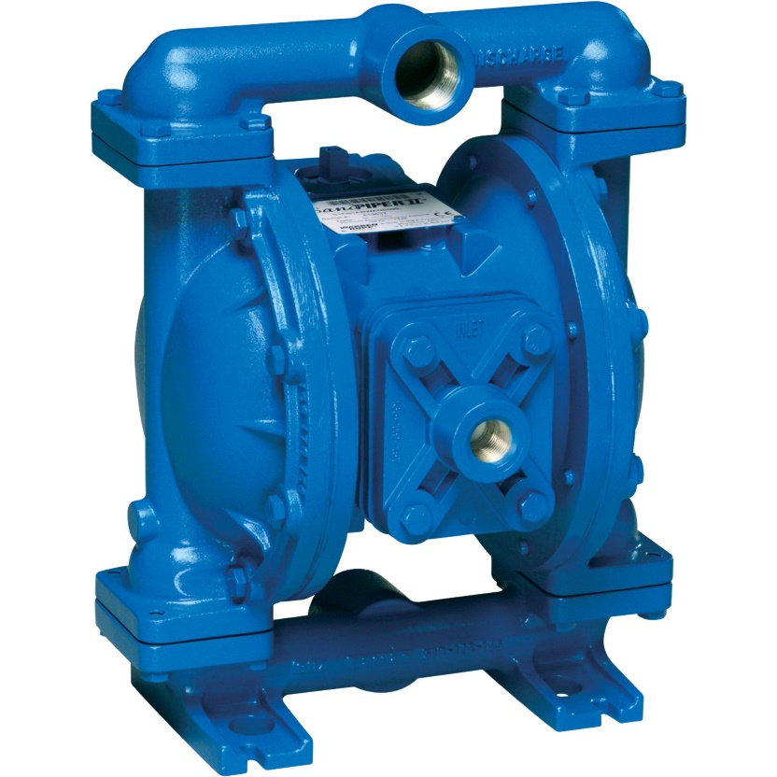
Diaphragm Pump
A positive displacement pump that uses a diaphragm to move fluids, often handling viscous or corrosive liquids.
It provides precise flow control and is suitable for applications involving hazardous or abrasive fluids.
BASE PRICE :

Slide 38
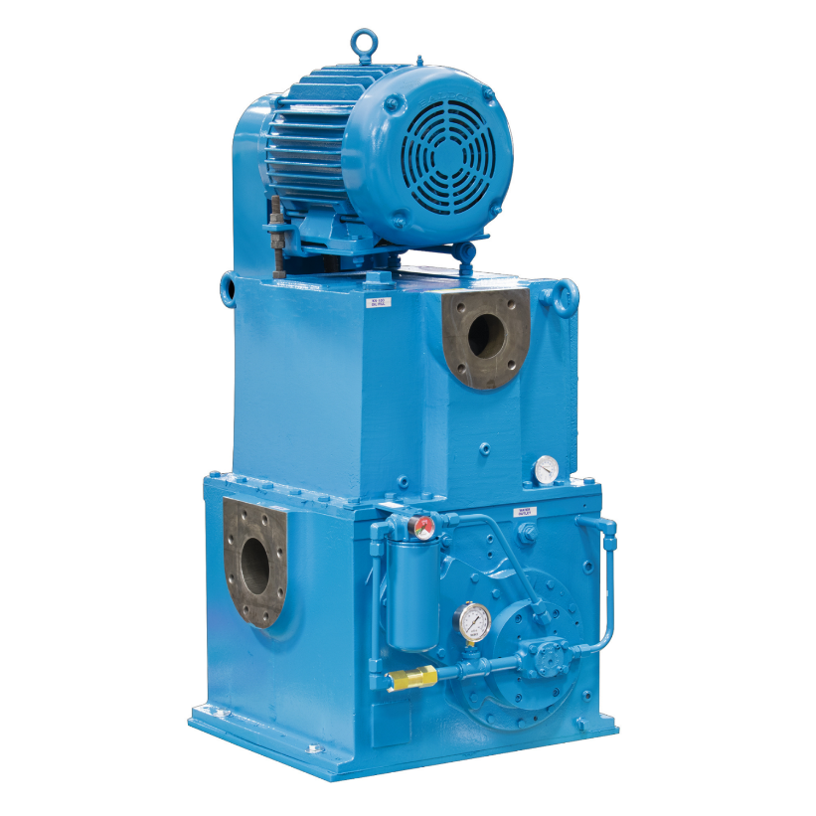
Single Stage Piston PDP
Uses a single piston to move fluids with high accuracy and pressure. It is commonly used in precise fluid transfer applications.
Ideal for tasks requiring consistent, accurate flow, such as dosing and hydraulic systems.
BASE PRICE

Slide 39
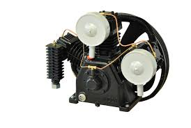
2- Stage Piston PDP
Features two pistons to deliver higher pressure output and handle more demanding fluid transfer tasks.
Frequently employed in industrial applications requiring high pressure and flow control.
BASE PRICE :

Slide 40
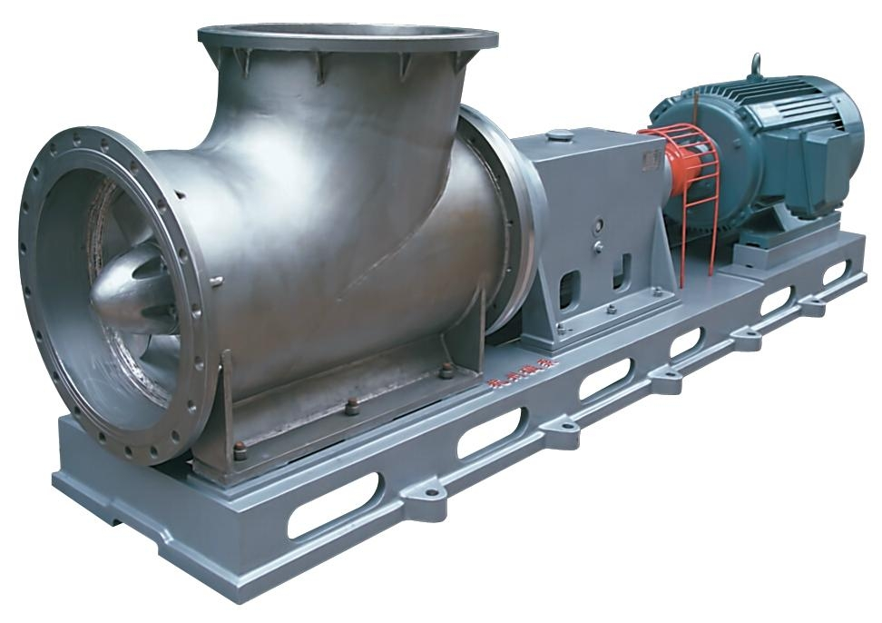
Axial Pump
An impeller-based pump that moves fluids along the axis of rotation, offering high flow rates at low pressure.
It is commonly used in applications such as cooling systems and irrigation, where large volumes of fluid need to be moved at low pressure.
BASE PRICE :

Slide 41
Product purification system

Slide 42
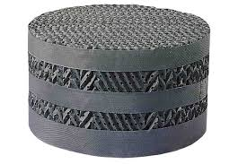
Structured Packing Column (Sulzer)
Sulzer structured packing is made of thin, corrugated sheets of metal, plastic, or ceramic that are arranged in a precise, regular structure. These sheets are stacked in layers, with each layer oriented at an angle to the one below it.
This design creates an open, crisscrossing flow channel that optimizes contact between liquid and vapor phases.

Slide 43
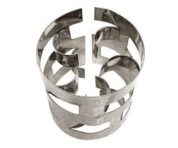
Pall Rings (Random Packing)
Pall rings are a type of random packing widely used in distillation, absorption, and stripping processes. They are cylindrical in shape with internal and external features that enhance their surface area and promote efficient mass transfer.
Unlike traditional Raschig rings, Pall rings have openings in their walls, which increase the liquid and vapor flow paths, reduce resistance, and improve overall performance.

Slide 44
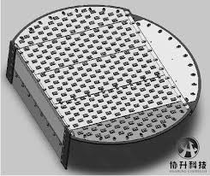
Sieve Tray Column
Sieve trays are a widely used type of tray in distillation and absorption columns, designed to facilitate efficient mass transfer between vapor and liquid phases.
They consist of a flat metal plate perforated with small holes that allow vapor to rise through the liquid flowing across the tray.
This interaction creates a frothy mixture, maximizing surface area for vapor-liquid contact and enhancing separation efficiency.

Slide 45
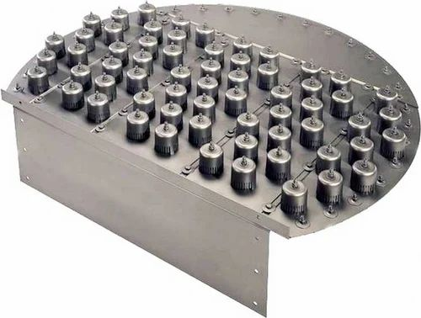
Bubble Cap Tray Column
Bubble cap trays are a traditional and versatile type of tray used in distillation and absorption columns. They consist of a perforated tray deck with caps (called bubble caps) placed over each hole.
These caps guide rising vapor through slots at their base, forcing the vapor to bubble through the liquid layer on the tray.

Slide 46
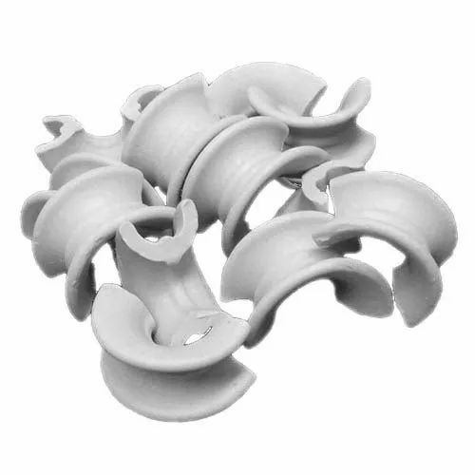
Berl Saddles (Random Packing)
Berl saddles are a type of random packing used in distillation, absorption, and stripping applications to enhance mass transfer efficiency. They have a saddle-like shape, designed to provide a high surface area for vapor-liquid contact.
This unique geometry ensures good liquid distribution and low pressure drop across the packing bed.

Slide 47
Utilities

Slide 48
Cooling Water
Cooling water systems circulate water to absorb and remove excess heat from equipment or processes, maintaining optimal operating temperatures.
It is widely used in industrial applications such as power plants and manufacturing for effective heat dissipation.
(150 kg of cooling water provided)
BASE PRICE :

Slide 49
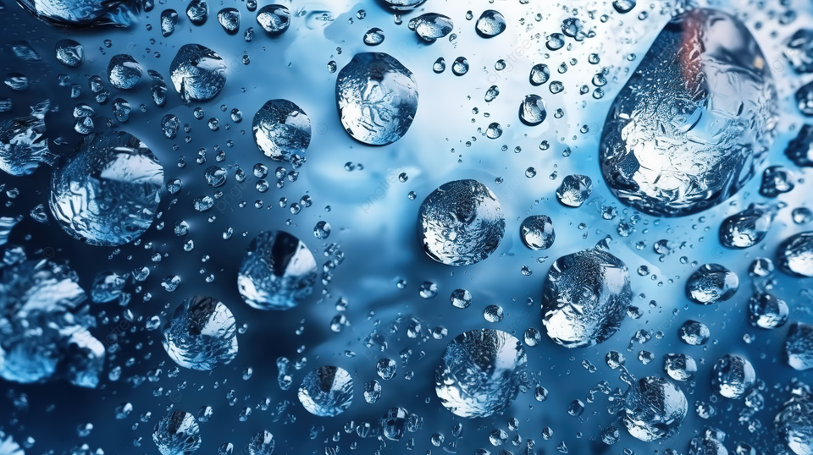
Chilled Water
Chilled water is used in air conditioning and industrial cooling systems to remove heat and maintain low temperatures.
It is circulated through systems to regulate temperature in buildings and processes that require consistent cooling.
(150 kg of chilled water provided)
BASE PRICE :

Slide 50

Steam
Steam is generated by heating water and used as a heat carrier in industrial applications such as heating, sterilization, and power generation.
It is commonly used in boilers, turbines, and chemical processes where thermal energy is required.
(4 MT of steam provided)
BASE PRICE :

Slide 51
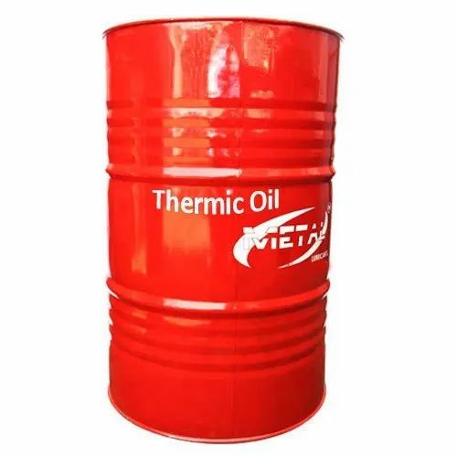
Thermic Oil
Thermic oil is a high-temperature heat transfer fluid used in closed-loop heating systems.
It operates at high temperatures without pressurization, making it ideal for industries requiring stable thermal control, such as in chemical processing.
(140 litres of Thermic oil provided)
BASE PRICE :

Slide 52
Choice of MoCs
You can select any of the following MoCs or lining materials for your equipment-
Stainless Steel (SS316)
Mild Steel
Carbon steel
Glass lining
Rubber lining
Teflon Lining

